Slide 1

FUCHS Intelligent Data Discovery Hackathon
BY DUMB CODERS
SAURAV KUMAR
YAMANI AKULA

Slide 2
Data extraction
Accuracy Achieved 2.83%
We extracted data from word and excel.
We have automated it using the python script that goes to each of the files.
Extracts the columns like report id, instruments, materials, results.

Slide 3
Data Engineering
We have followed the ETL process.
Transformation
Splitting the products
Cleaned the machine names.
Take care of null values.
Mapping by respective codes
Arranged according to the result
Load the data

Slide 4
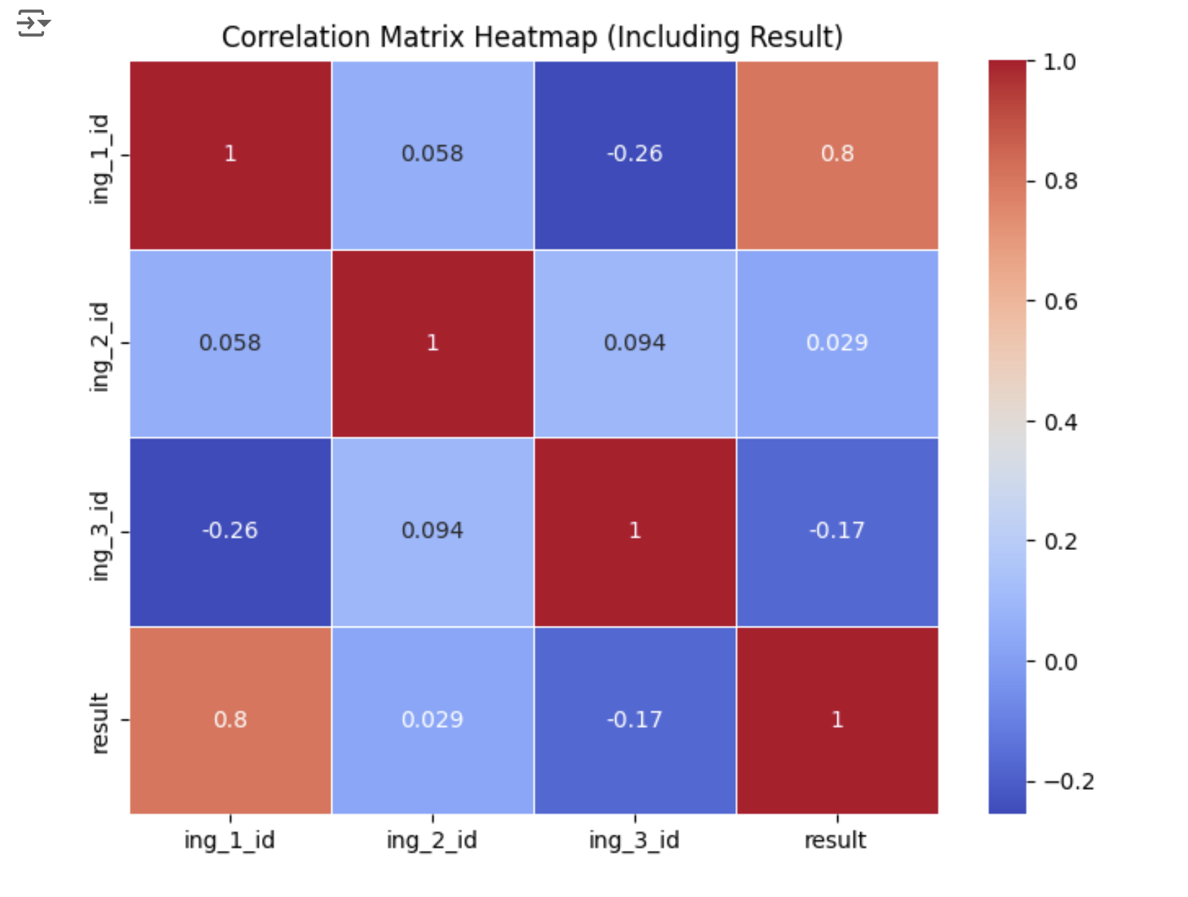
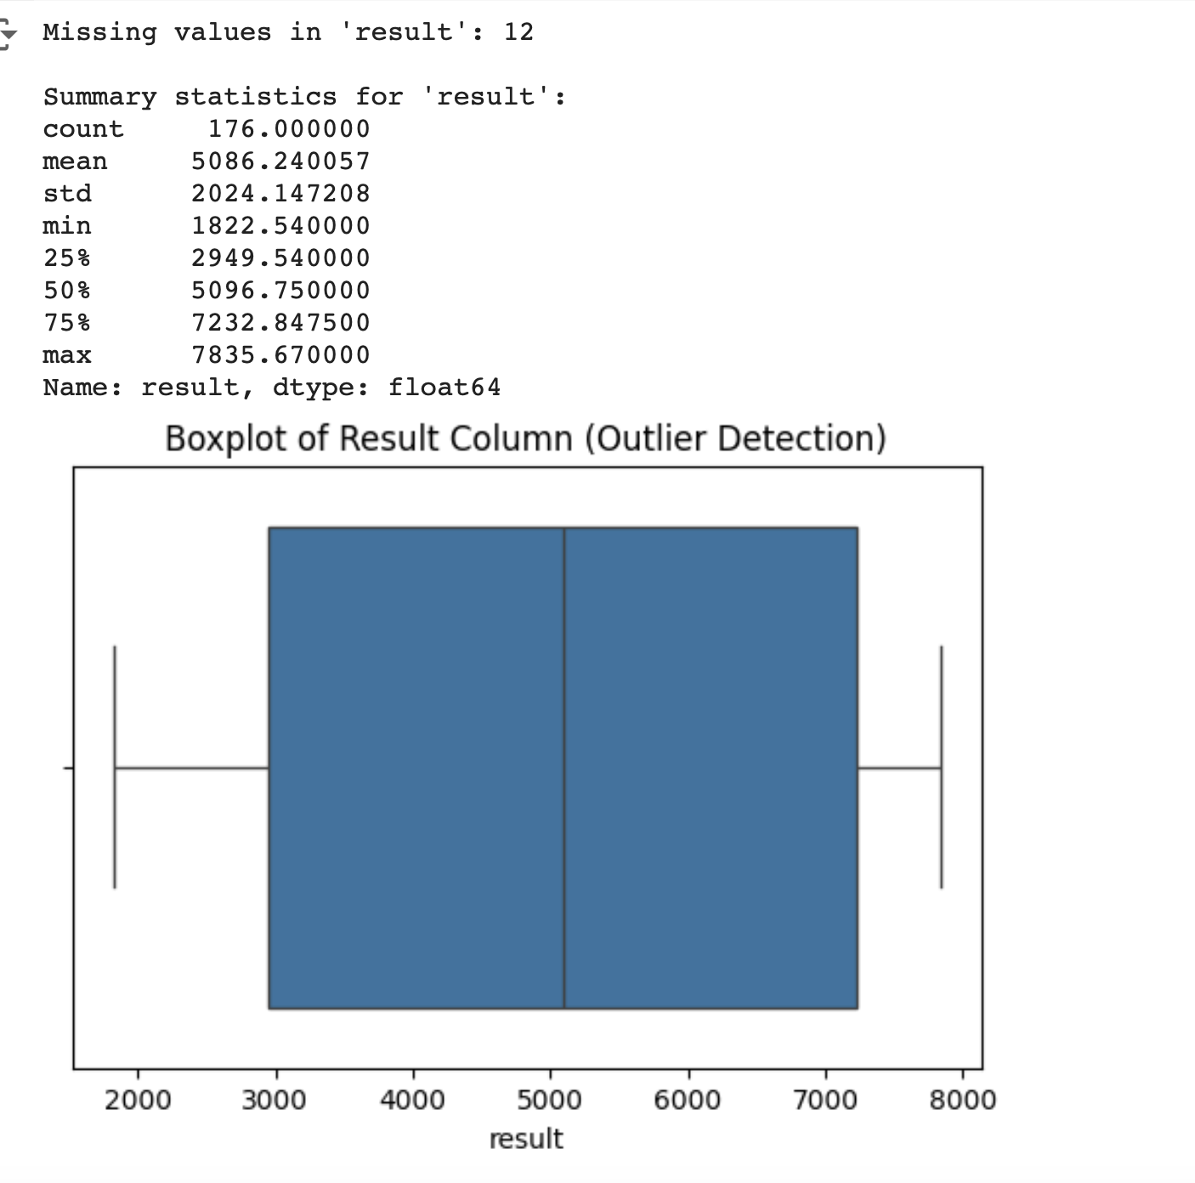
Data modelling
Following the various stages of machine learning pipeline

Slide 5
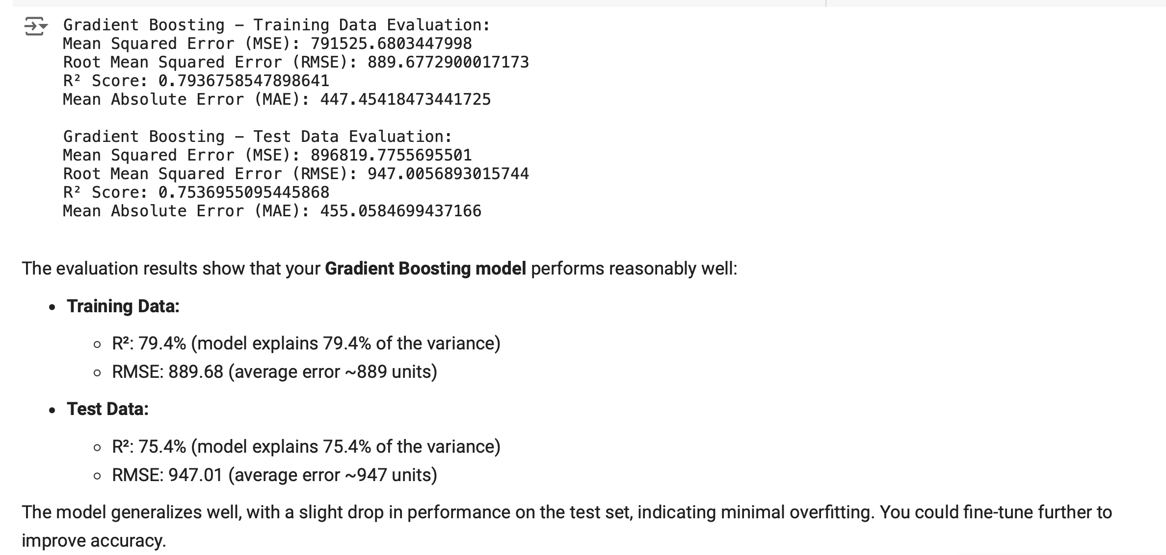
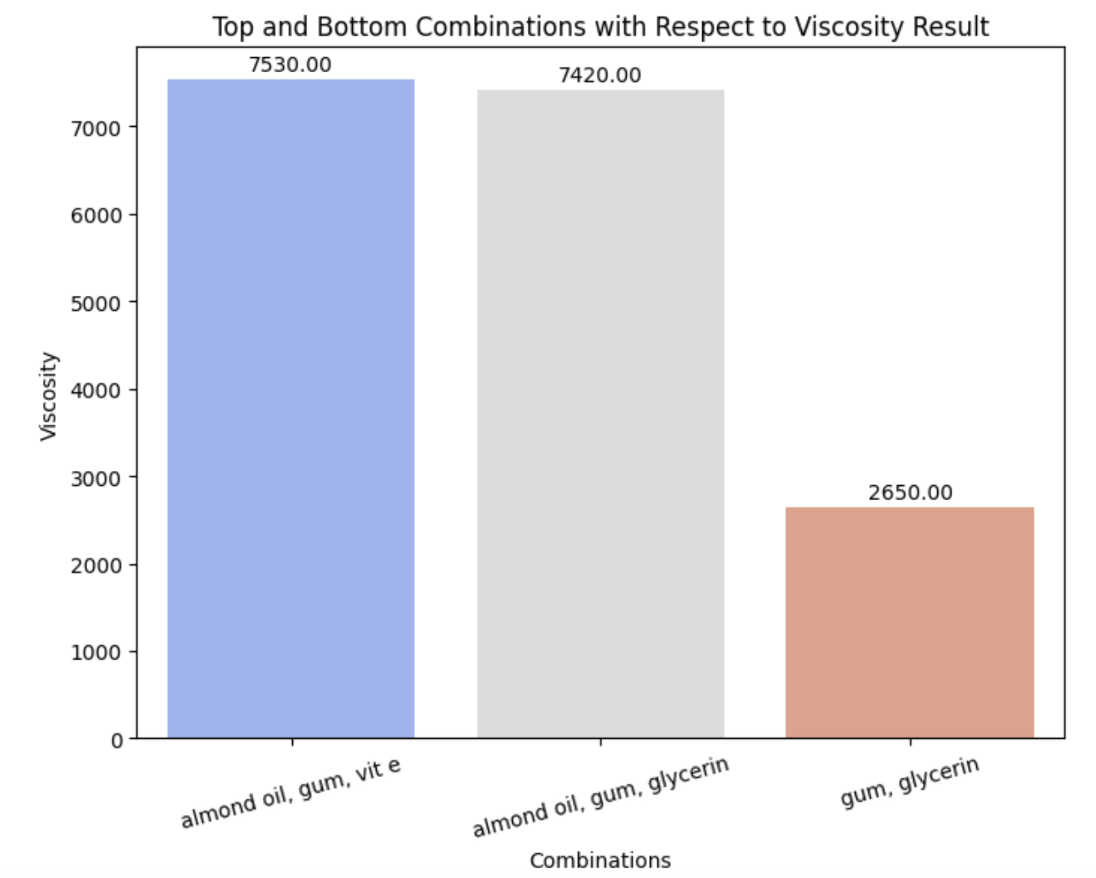
Data modelling

Slide 6
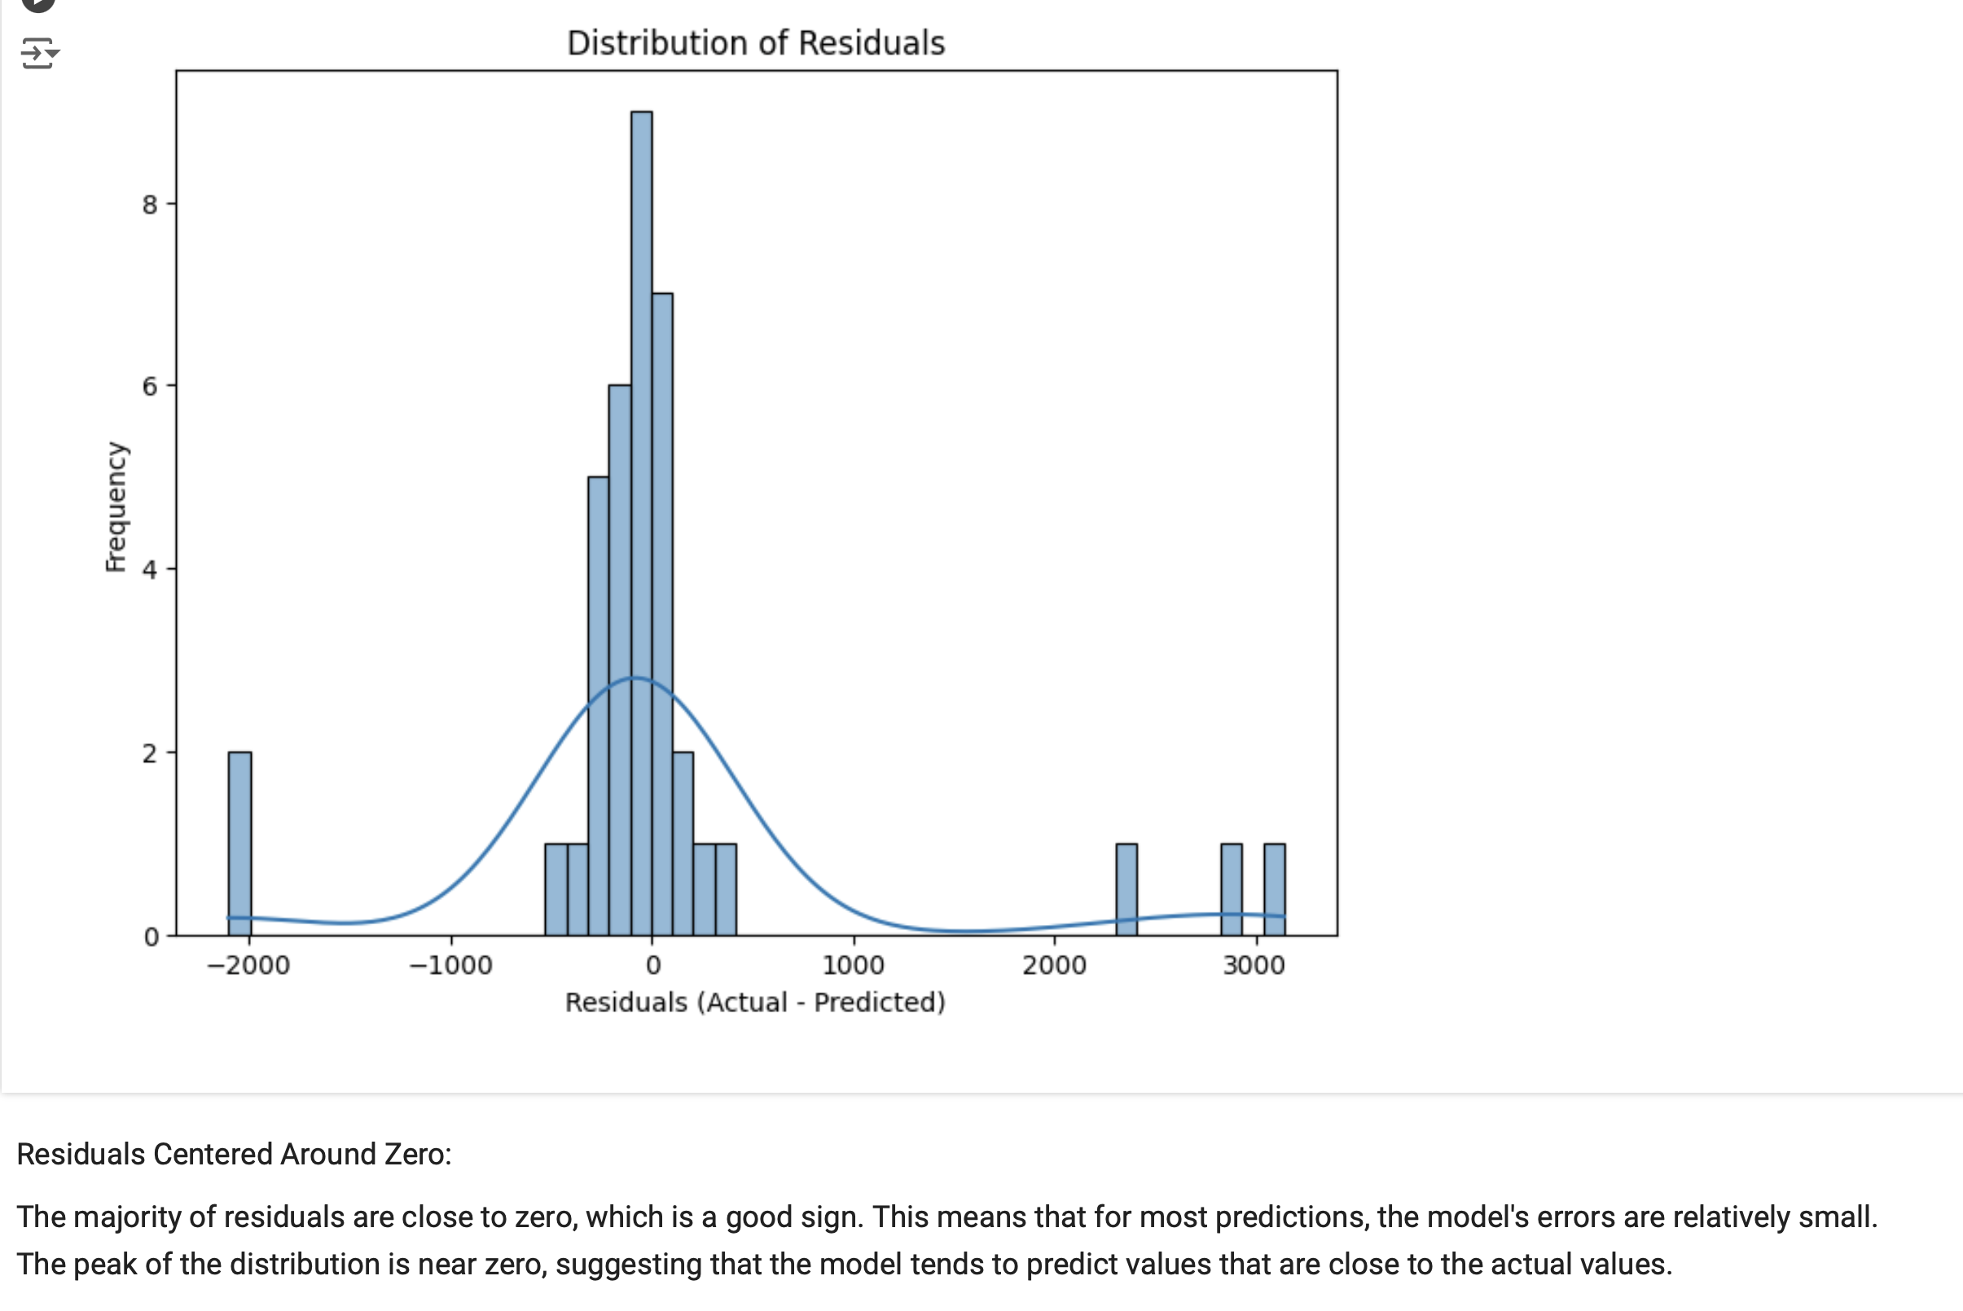
Data modelling

